Slide 1






TruPress
PITCH DECK
HACKATHON
PITCH DECK
PITCH DECK
PITCH DECK
01
https://truepress.amssr.org

Slide 2

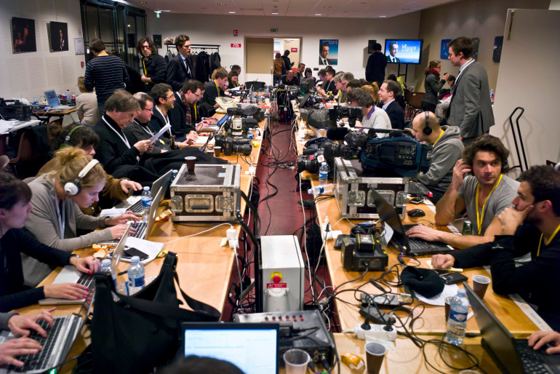
TruPress
PITCH DECK
PROBLEM
STATEMENT
PITCH DECK
Over the years, Nigerian journalists have been prevented from speaking the truth that they find during events due to numerous harassment and death threats that they faced from political forces and violence from the Nigerian police and military even more painful, Nigerians have been denied access to crucial information that tells the truth and have been restricted in expressing themselves both in person before the government and online.
PITCH DECK
02

Slide 3
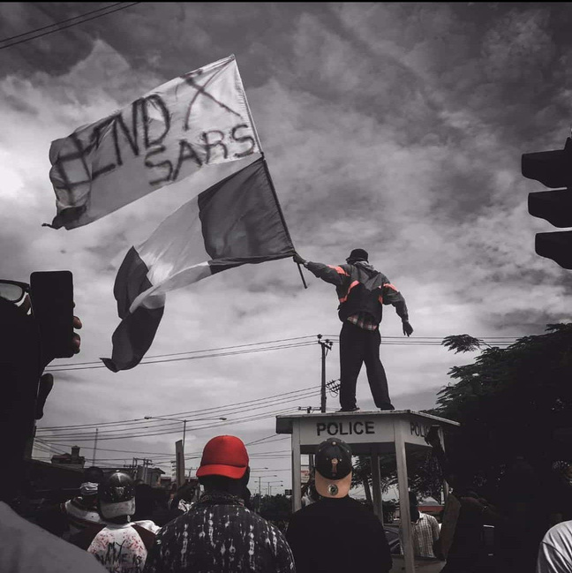
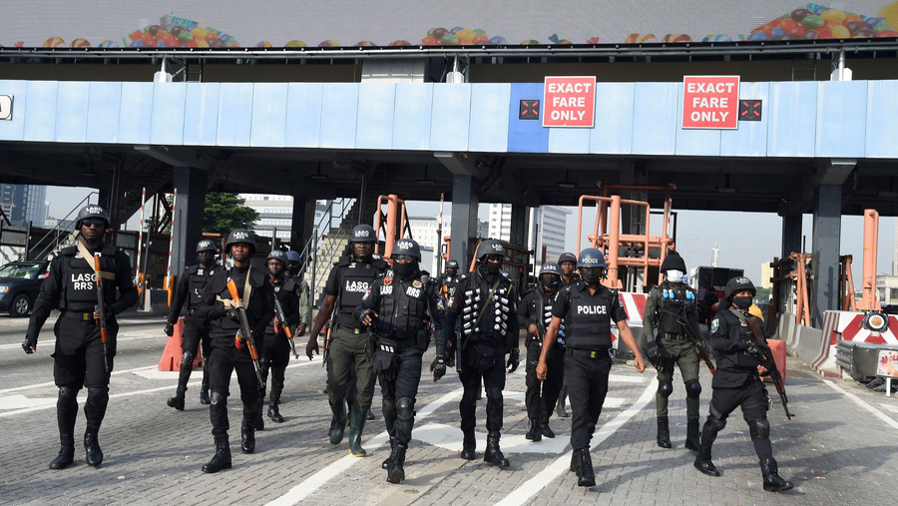
TruPress
THE
PROBLEM
Let’s start with the 7 months Twitter ban in Nigeria that restricted journalists from sourcing and dropping information on the platform which was not only at their disadvantage but it was also a threat to our human right.
Also the Lekki Toll Gate massacre where a 20yrs old journalist, Pelumi Onifade was shot and arrested despite wearing a professional jacket(he died later under the police custody) or is it the End Sars protest where 56 journalists where attacked while trying to document the event.
Why should journalists be afraid to report on issues that affect the people, especially in a democracy?
There’s supposed to be a difference between the modern era and the military era but people still compare them because the yardstick is supposed to be different since we are under a democracy.
03

Slide 4



OUR
TruPress
SOLUTION
1. Immutable Content Storage
At the core of TruPress lies the promise of immutable content storage. In simple terms, once a journalist publishes content on TruPress, it cannot be modified or erased, ensuring its lasting presence on the blockchain. This feature is powered by the Lisk network, which underpins each submission with a decentralized and secure infrastructure.
2. Anonymity and Security
In the interest of preserving journalists' safety, TruPress includes robust anonymity features. This level of protection allows journalists to submit work without fear of reprisal.
With a security-first approach, TruPress offers layers of encryption and anonymization. Journalists can choose to publish without associating their real identity, and the Lisk blockchain framework supports this by allowing anonymous transactions and smart contract interactions without compromising security.
04

Slide 5
OUR
TruPress
SOLUTION
3. Decentralized Access
TruPress’s commitment to decentralized access makes the platform a true pioneer in providing uncensored information. Hosted on the Lisk blockchain, TruPress does not rely on traditional centralized servers, which can be targeted for censorship or data manipulation. Instead, the decentralized nature of the blockchain guarantees that content remains available to users around the globe, withstanding any form of centralized control or interference.
4. User-Friendly Submission Portal
TruePress’s submission portal was thoughtfully designed with journalists in mind. The interface is minimalist, intuitive, and accessible, enabling journalists to upload content in a matter of minutes. We spent significant time perfecting this portal, conducting multiple design iterations to optimize the user experience.
To make the portal user-friendly, the team employed a combination of WordPress’s theme customization and proprietary PHP scripts. The submission workflow is streamlined, with an easy drag-and-drop upload feature for multimedia files, clear fields for article titles and descriptions, and options to set anonymity preferences.
05

Slide 6

1. Blockchain Network: Lisk
Lisk serves as the backbone of TruPress, selected for its scalability, efficiency, and developer-friendly environment. Lisk’s flexible architecture allows TruPress to build secure, immutable, and decentralized content storage solutions that align perfectly with the platform’s objectives.
2. Frontend: WordPress
TruPress’s frontend leverages WordPress for its rapid development capabilities and ease of customization. The team selected WordPress for its robust community, extensive plugin ecosystem, and compatibility with custom HTML, CSS, and PHP, allowing them to build a custom interface tailored to TruePress’s requirements.
Using WordPress plugins and custom code, they were able to create a sleek, efficient, and responsive front end that meets the high standards of both journalists and readers.
3. Backend: WordPress PHP Framework and Lisk SDK
The backend combines WordPress’s PHP framework with the Lisk SDK. This dual approach allows TruePress to manage content on the blockchain seamlessly. WordPress handles UI and UX interactions, while the Lisk SDK facilitates content immutability and decentralized storage.
The integration with Lisk’s API ensures that every post submitted through WordPress is recorded on the blockchain in real-time, demonstrating the team’s proficiency in merging traditional web development with blockchain technology.
TruPress
TECHNICAL
DETAILS
PITCH DECK
PITCH DECK
06

Slide 7
TruPress
4. Additional Tools
To enhance the functionality and performance of TruPress, we employed additional tools:
Lisk API Integration: Provides smooth interaction between WordPress and the blockchain.
Media Storage Optimization: Ensures efficient handling of multimedia files, preserving performance without compromising quality.
These tools reflect a thoughtful approach to designing a system that accommodates the demands of modern journalism.
5. Design Considerations
TruPress’s design is driven by principles of clarity, accessibility, and trust:
Typography: Thoughtfully selected fonts that convey trustworthiness, reliability, and readability on large screens.
Responsive UI: Designed for an optimal reading experience across devices, with special emphasis on desktop layouts for improved accessibility.
Each design decision was intentional, reflecting the team’s deep understanding of what TruePress needed to become: a secure, accessible, and visually appealing platform that meets the unique needs of journalists.
TECHNICAL
DETAILS
PITCH DECK
PITCH DECK
07

Slide 8
TruPress
PITCH DECK
OUR
TEAM
Somtochukwu Onyekwelu
Full-Stack Developer
Chidi Eze
During the project building, our team truly showcased their dedication and hard work. Each member brought their unique skills and expertise to the table, resulting in a cohesive and impressive presentation. From the thorough research to the polished delivery, it was evident that every team member put in the time and effort to ensure our pitch was top-notch. The commitment to excellence and the collaborative spirit truly shone through, and I am proud to be a part of such a hardworking team.
Ezema Sonia Mmesoma
Project Manager
PITCH DECK
Ekene Ukwunna Emmanuel
Smart Contract Developer
PITCH DECK
08

Slide 9
TruPress
MILESTONES AND
ROADMAP
09

Slide 10
TruPress
MONTH 1-3
ROADMAP TO FREEDOM – THE PATH TO PRESS PROTECTION
Month 1: Enhancing Anonymity & Decentralized Storage
Goal: Secure journalist identity and remove dependency on centralized storage.
Key Actions:
Implement Tor access and Zero-Knowledge Proofs to enable anonymous submissions.
2.Transition to IPFS for decentralized, immutable file storage.
3. Set up a donation model to sustain storage costs, maintaining affordability.
Month 2: Immutability & Censorship Resistance
Goal: Lock content in place and guarantee access from any location.
Key Actions:
Enable irreversible publishing on Lisk blockchain, ensuring content permanence.
2. Establish Tor and IPFS-based mirrors to allow access in restricted regions.
Month 3: Introduce encryption for all files, reinforcing security against tracking.
Goal: Support journalistic integrity and safeguard global access.
Key Actions:
Launch decentralized identity credentials, letting reporters verify credibility without revealing personal data.
2. Increase IPFS redundancy for stable content availability.
3. Run community outreach for journalist onboarding and donation support.
10

Slide 11
TruPress
CONCLUSION:
THE VISION OF OUR SOLUTION
We aim to solve the problem of the oppression of press that is, us.
With this roadmap, we have an incredible and structured path to take TruPress from an MVP to a fully functional, resilient, censorship-proof platform that journalists can rely on for securely publishing news without fear of governmental interference or threats of violence.
11

Slide 12



TruPress
THANK
YOU.
GET IN TOUCH
WITH US
https://truepress.amssr.org
@TruPress_1
mmesoniaweb12@gmail.com
12
+2348131106011

